Slide 1


Foreign Direct Investment
Sector and financial year-wise data of FDI in India Sector-wise investment analysis Year-wise investment analysis
By Tejas Golhar

Slide 2
INTRODUCTION
INTRODUCTION
Ministry of Commerce and Industry has published Financial Year wise FDI Equity Inflows from 2000-01 to 2016-17 dataset in Open Government Data Platform India under Govt. Open Data License - India. Dataset contain the information about How much FDI has changed over the year? How much has varied since 2014 after Narendra Modi become PM of India?
FDI is one of the parameters through which the growth and development of a country can be measured on a global level but the ground-level reality of this development has to be analyzed to really understand the benefit that India has got from FDI.

Slide 3
Project Title | Analyzing Foreign Direct Investment Data
Technologies | Data Science
Domain | Finance
Project Difficulties Level | Intermediate
Foreign Direct Investment
Analysis
Resources
Name : Foreign Direct Investment
Dataset : Download Dataset

Slide 4
PROBLEM STATEMENT
Problem Statement
Investment is a game of understanding historic data of investment objects under different events but it is still a game of chances to minimize the risk we apply analytics to find the equilibrium investment.
To understand the Foreign direct investment in India for the last 17 years from 2000-01 to 2016-17. This dataset contains sector and financial year-wise data of FDI in India Sector-wise investment analysis Year-wise investment analysis.
Find key metrics and factors and show the meaningful relationships between attributes. Do your own research and come up with your findings

Slide 5
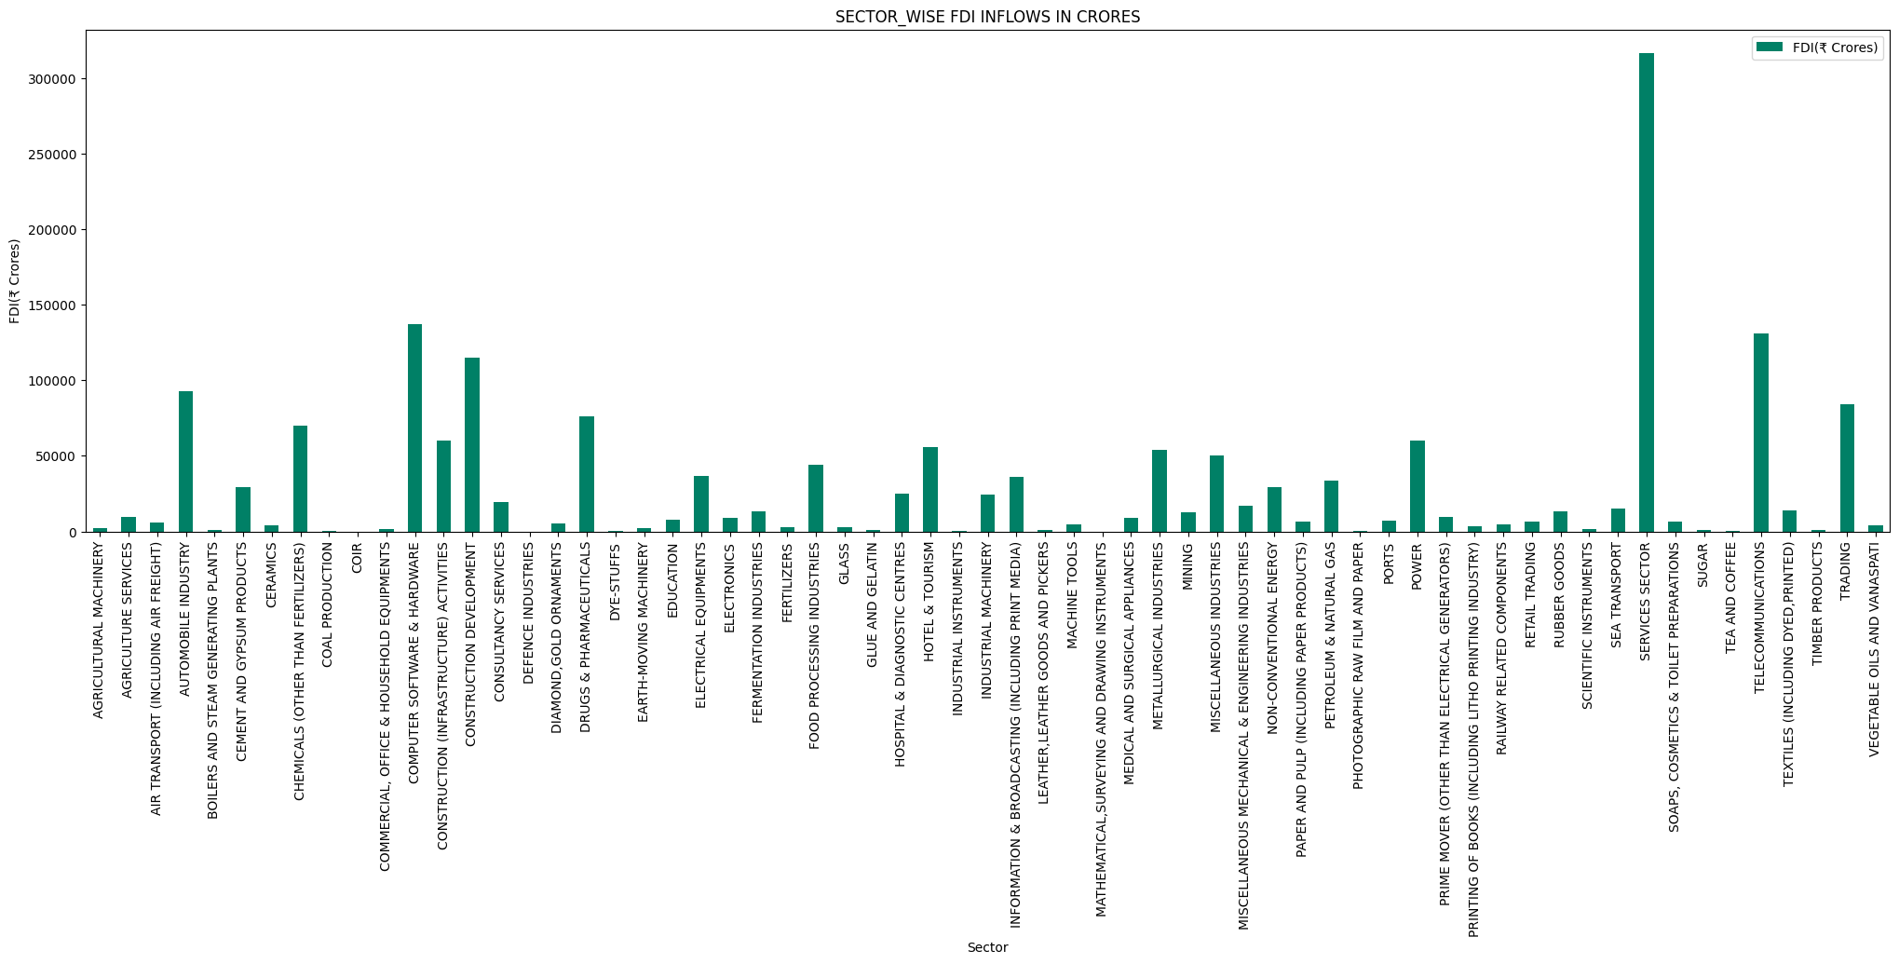
Foreign Direct Investment
Analysis

Slide 6
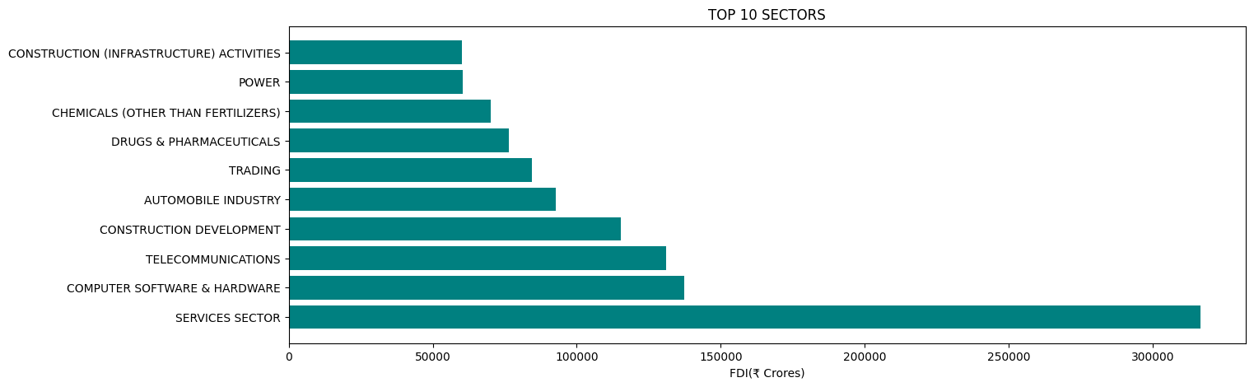
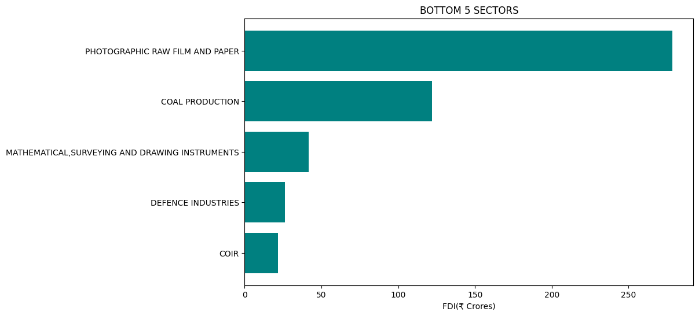
Total FDI inflow in
top 10 sectors
Foreign Direct Investment
Analysis
Total FDI inflow in bottom 5 sectors

Slide 7
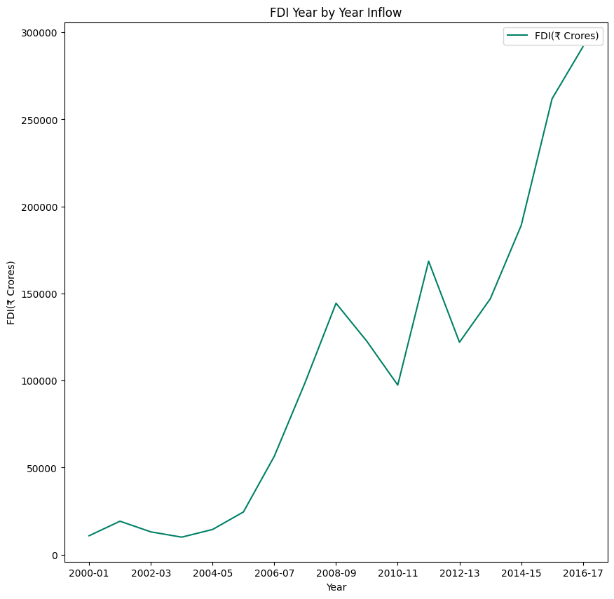
Foreign Direct Investment
Analysis
Year by Year FDI
Inflow

Slide 8
Conclusion
Conclusion
The Sectoral composition of FDI over the period of April 2000 to June 2017, we can find that the largest recipient of such investment is service sector (Financial and non-financial services). The share of this sector in FDI flows is 17 % of the inflow total foreign direct investment.
The foreign investors are interested in mainly financial services due its profit generating advantage. This sector gives scope for the foreign investor to takes back the profits to the home country. As service sector the services are consumed in the host country and there by generating outflow of funds from the host country.
Their is very low interest towards sectors like Coir, Defense Industries, Mathematical, surveying and drawing Instruments, Coal Production and there are around 28 to 30 sectors where share is less.

Slide 9
WEEK 4
Tableau Dashboard

Slide 10
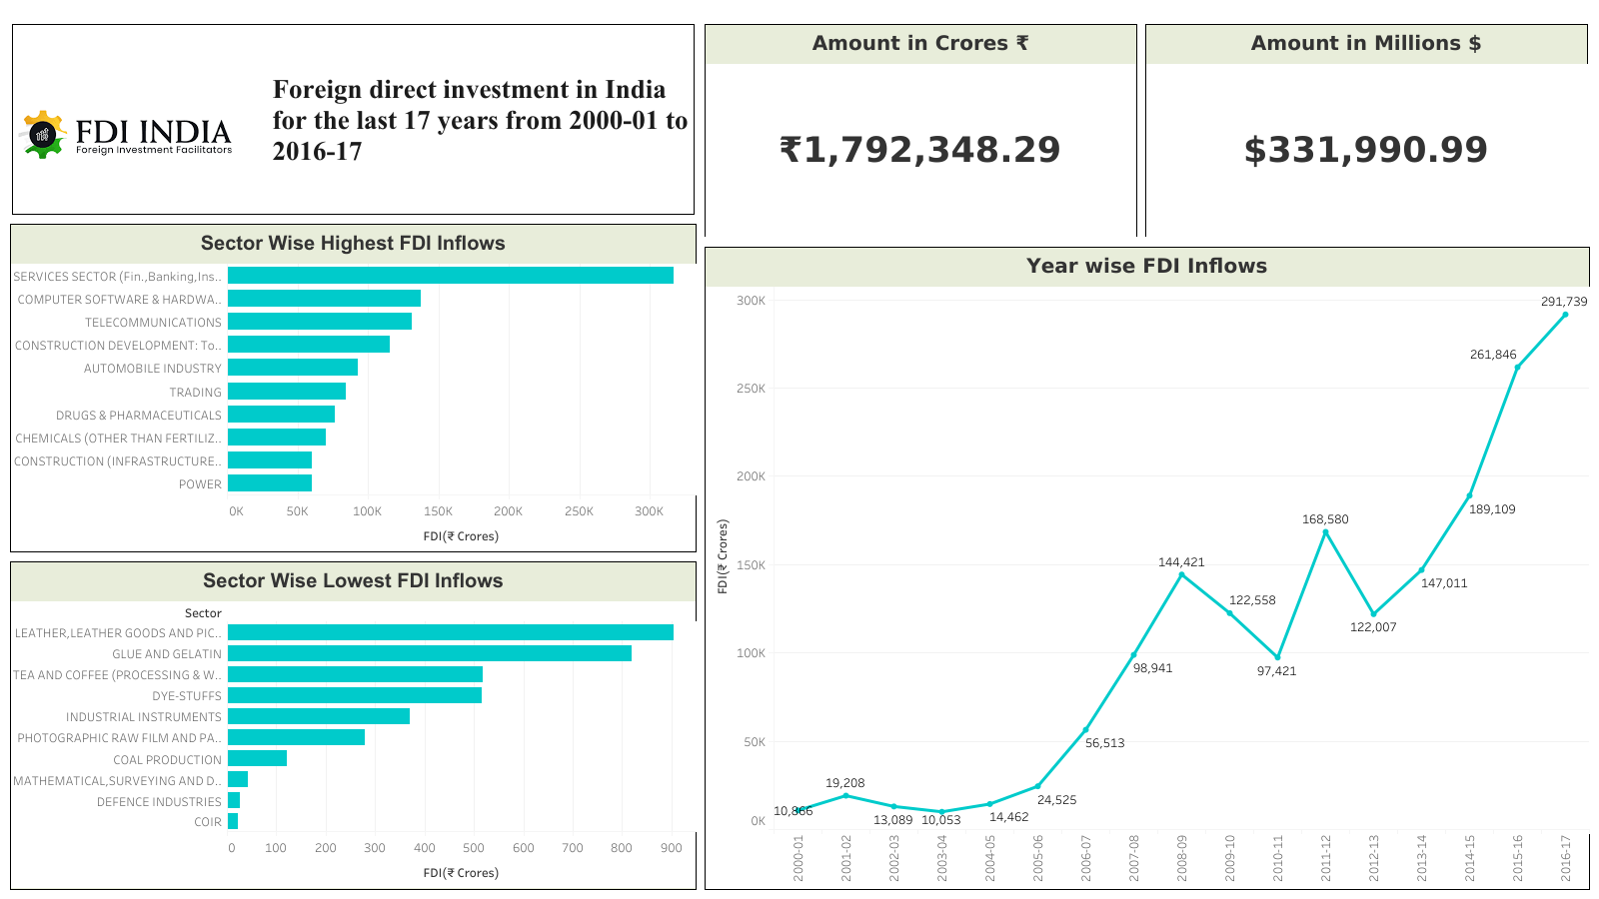

Slide 11
Project Work
WEEK 4
Python Notebook
Tableau Dashboard
Check Here
Check Here

Slide 12
Foreign Direct Investment Analysis
Thank You

